Slide 1

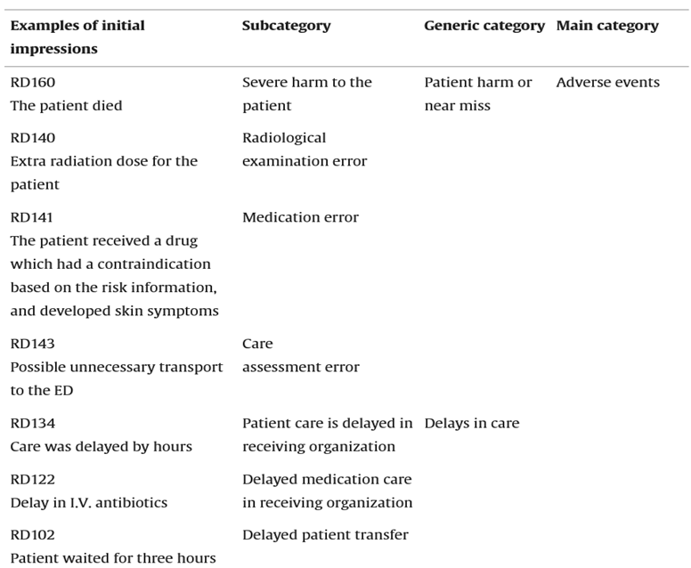
ANALYSIS OF HEALTH INFORMATION EXCHANGE SYSTEMS
IMPACT ON CARE IN ADULT PATIENTS
KALI PRASAD KANCHETI
Advisor(s): Prof. Stephen Burrows & Prof. Susan Candido
Sacred Heart University, Fairfield CT
INTRODUCTION
RESULTS
DISCUSSION
HIE systems secure data sharing, improving care coordination by addressing siloed health data risks.
Key barriers to HIE adoption include interoperability, security concerns, costs, and resistance.
Study assesses HIE's impact on care coordination and errors to guide deployment, enhancing patient safety and care quality.
Purpose: To evaluate the impact of Health Information Exchange (HIE) systems on care coordination and medical errors in adult patients.
Research Question:
How do Health Information Exchange (HIE) systems affect care coordination and the incidence of medical errors in adult patients?
HIE improved quality and safety: informed decisions, coordination, and medication management.
Increased efficiency: streamlined workflow, reduced redundancy, optimized resources.
Enhanced patient engagement: personalized access, self-care, satisfaction.
Address privacy, security, and regulatory issues; promote data-sharing and interoperability.
The multidimensional approach targets technical, human elements for HIE success.
HIE systems improve care quality and patient safety by reducing medication errors, readmissions, and inpatient, and post-discharge mortality.
They increase efficiency by streamlining workflows, minimizing redundancy, sharing information, and optimizing resources.
HIE enhances patient engagement through personalized data access, self-care support, improved communication, and greater patient involvement.
Adoption is facilitated by perceived benefits, system trust, convenience, and familiarity, but hindered by privacy/security concerns, regulatory obstacles, interoperability issues, and data-sharing agreements.
CONCLUSION
HIE systems enhance care integration, safety, staff performance, patient satisfaction, and reduce errors, readmissions, and mortality by improving communication and information completeness. They boost productivity through efficient workflows, cost savings, and eliminating redundancies.
Challenges include interoperability gaps, privacy/security issues, and regulatory factors, with solutions involving data-sharing agreements, staff training, and blockchain technology. Further research on long-term impacts and AI/blockchain solutions is needed
METHODS
Shows the consequences of inter-organization HIE-related incidents
Database Search: Conducted across PubMed, CINAHL, Scopus, and Web of Science.
Search Terms: Included keywords related to health information exchange (HIE) systems.
Selection: Peer-reviewed articles in English from 2018 to 2024.
Inclusion Criteria:
Studies from developed countries with healthcare systems similar to the target context
Empirical research using quantitative, qualitative, or mixed methods
Exclusion Criteria:
Studies from low-income settings
Non-empirical methods
Non-English languages
Studies with unclear methodology
Themes Identified:
Thematic analysis
Content analysis
Meta-analysis
Data synthesis techniques were used for qualitative and quantitative data analysis.
REFERENCES
Bronsoler, A., Doyle, J., & Van Reenen, J. (2022). The impact of health information and communication technology on clinical quality, productivity, and workers. Annual Review of Economics, 14, 23-46.
Eden, R., Burton-Jones, A., Grant, J., Collins, R., Staib, A., & Sullivan, C. (2019). Digitising an Australian university hospital: qualitative analysis of staff-reported impacts. 44(5), 677-689..
(Bronsoler, Doyle, & Van Reenen, 2022)
Healthcare Informatics Capstone Poster Session – Late Spring 2024

